Slide 1
Wines Around the World
Fabio Braga
Tuyet Nguyen
Irwin Mier
Anisha Nigam
Nicholas DiBiase
Magnus Doughan

Slide 2
Contents
For this project we use a combination of instructed class materials, including:
Python, Pandas, Matplotlib, Tableau, AWS, and Machine Learning (SciKit-Learn for Linear Regression, Random Forest Classifier, and Neural Networks with Keras)
Dataset consisting of over 150K records, still with over 92K after cleanup.
Use Machine Learning to answer the following key questions:
1) Is there a correlation between Points vs. Price
2) Can our model accurately predict wine rating based on description?
3) Is it possible to predict the price of a wine based on its description and variety?

Slide 3
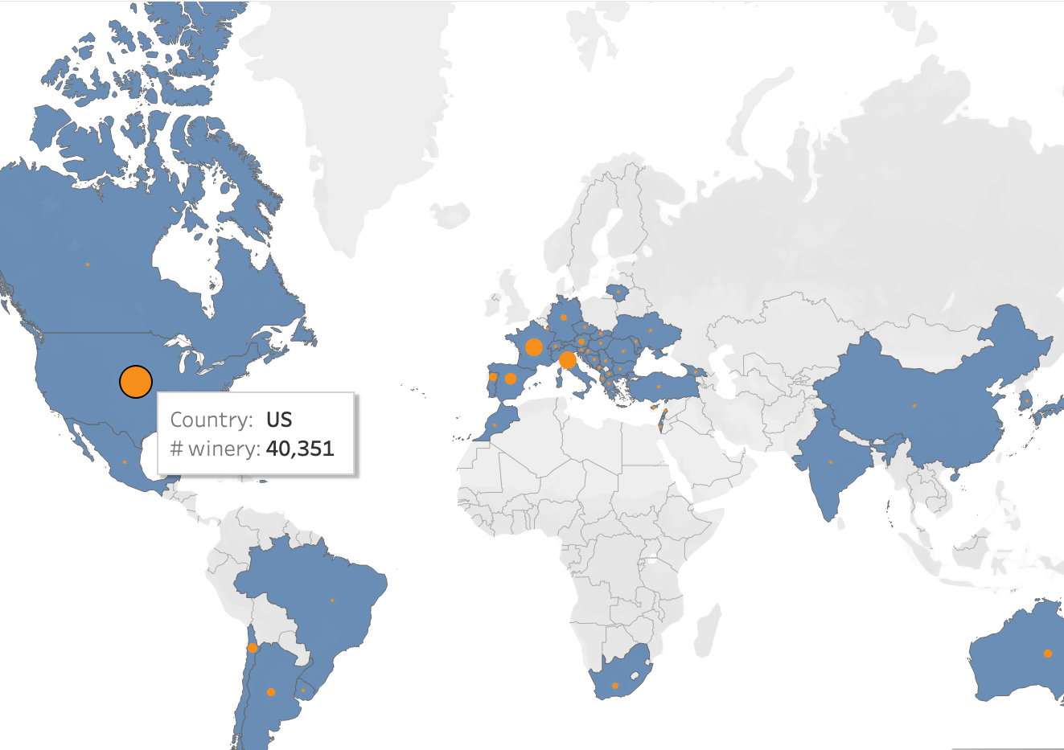
World Distribution

Slide 4
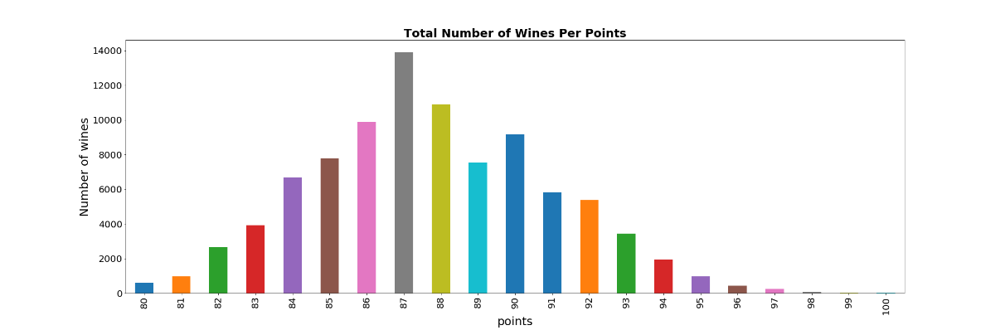
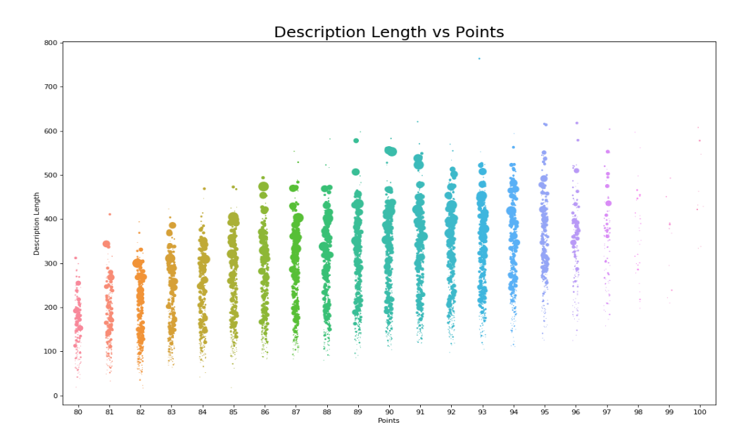
Rating Distribution

Slide 5
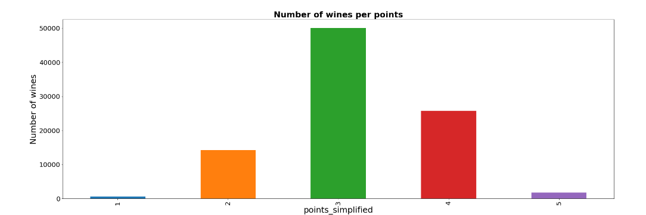
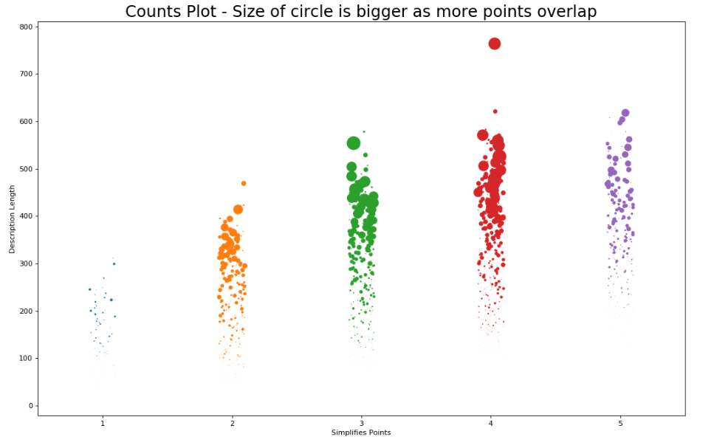
Rating Distribution (simplified)

Slide 6
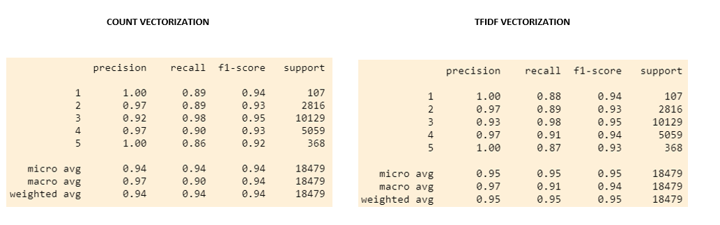
Vectorization w/ Training and Testing Results

Slide 7
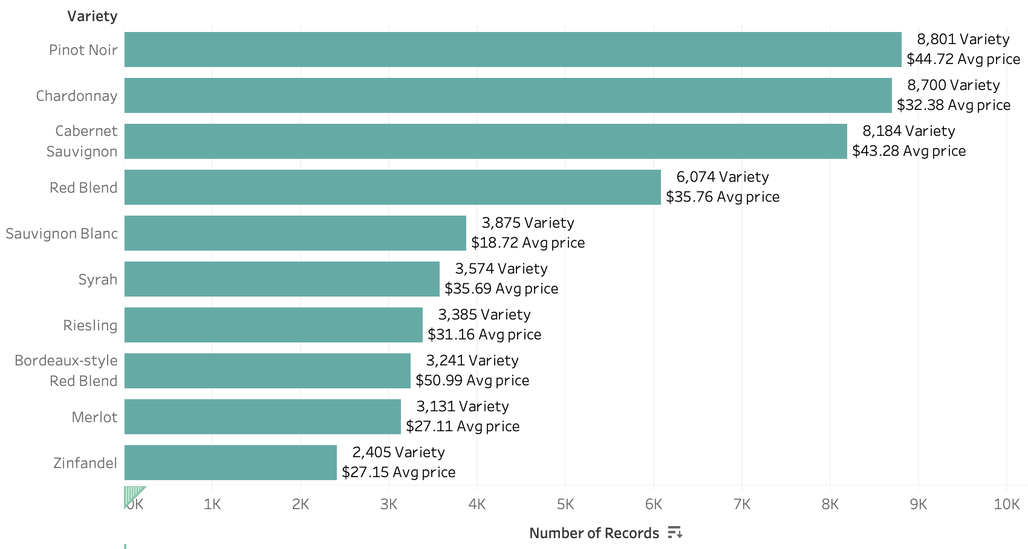
Top 10 World Varieties

Slide 8
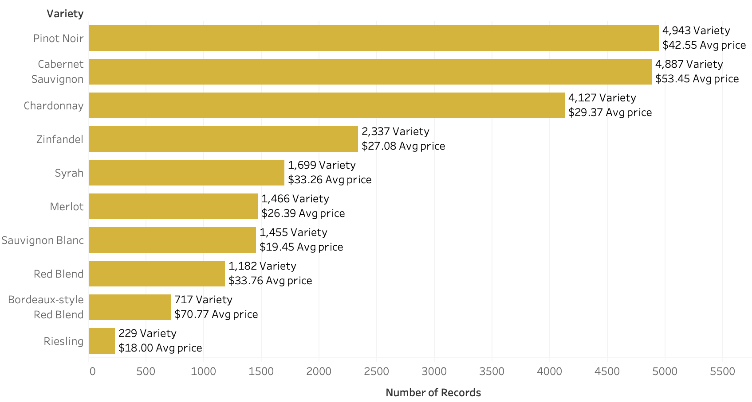
Top 10 California Varieties

Slide 9
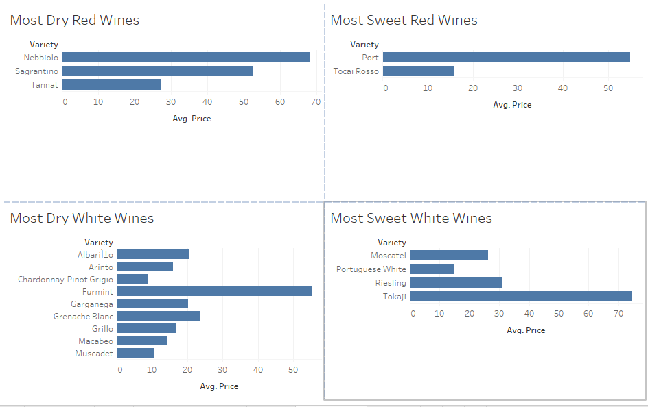
From Dry to Sweet

Slide 10
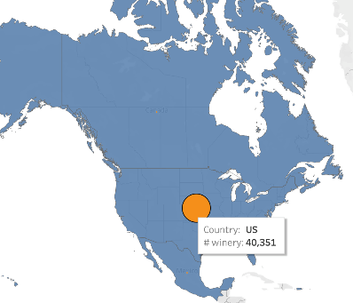
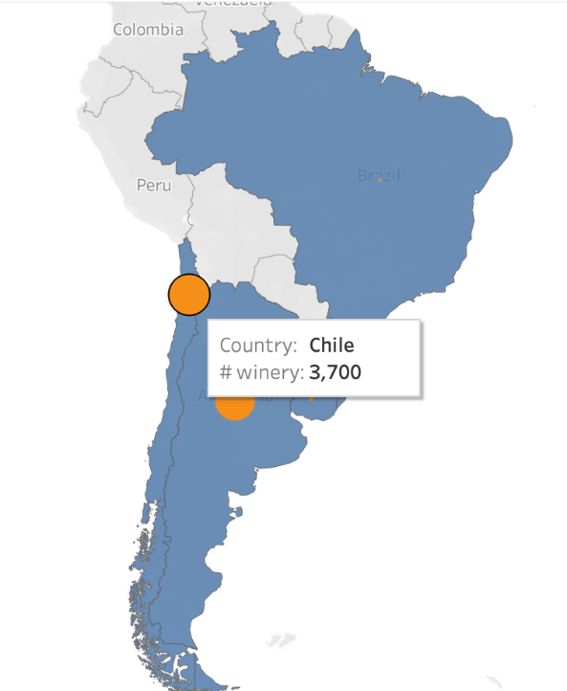
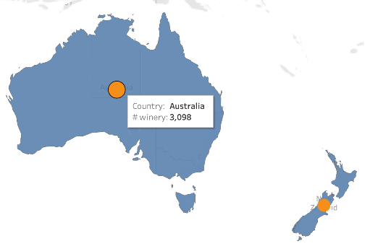
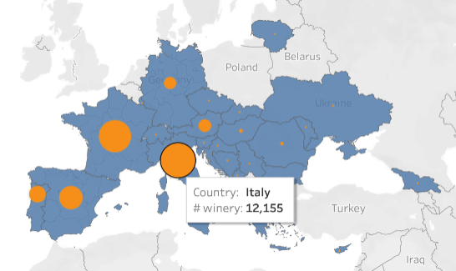
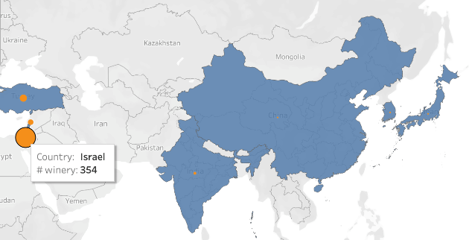
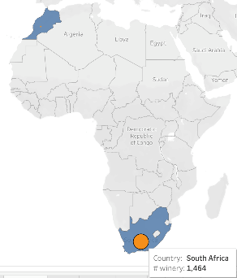
Top Countries per Region

Slide 11
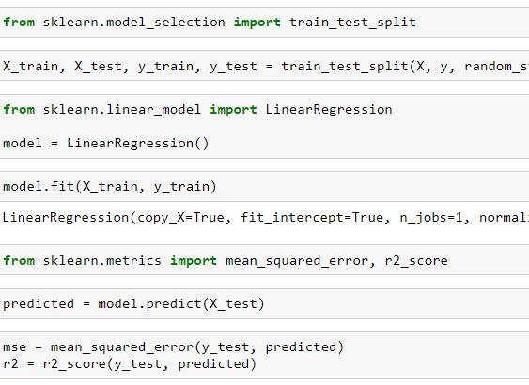
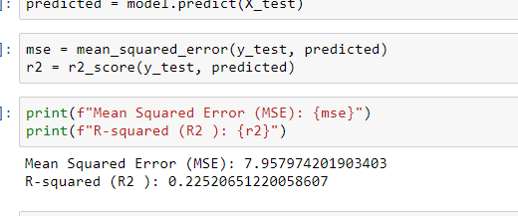
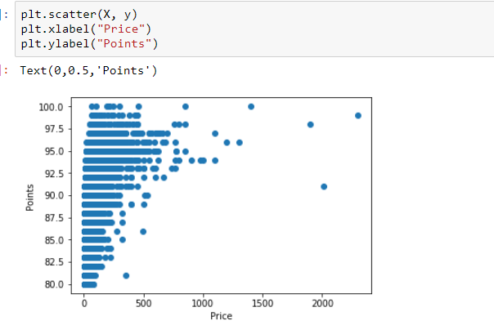
Correlation Between Points and Price

Slide 12
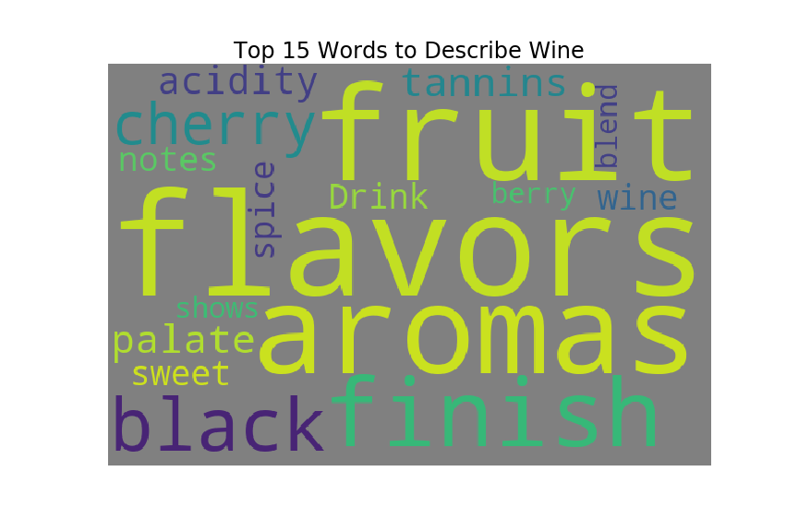
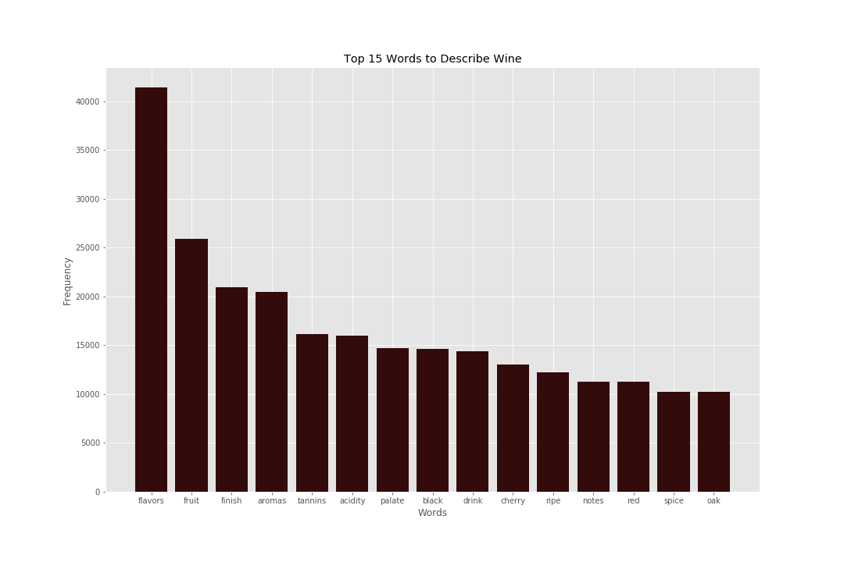
Fun Facts

Slide 13
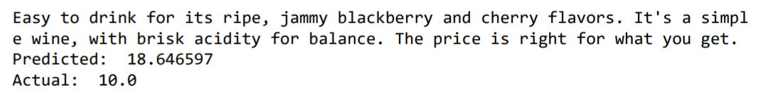
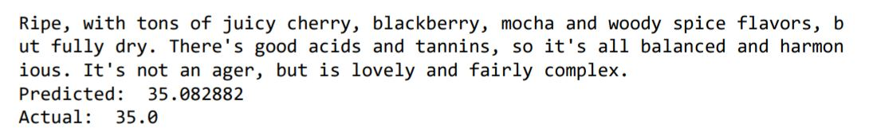
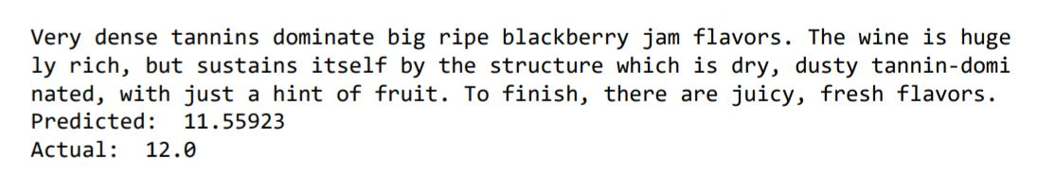
Is it possible to predict the price of a wine based on its description and variety?
Yes, it is possible.

Slide 14
Appendix
Slide # | Content
3 | Tableau
4 | Python Matplotlib
5 | Python Matplotlib
6 | ML: Vectorizations/RandomForest
7 | Tableau
8 | Tableau
9 | Tableau
10 | Tableau
11 | Linear Regression
12 | Python Matplotlib
13 | Pandas, Tensorflow, Tokenizer,

